Slide 1

Serving on the Board/Council
SILC Congress 2025
Orlando, FL

Slide 2


Independent Living Training and Technical Assistance Center
The IL Training & Technical Assistance Center is operated by the University of Montana’s Rural Institute for Inclusive Communities (RIIC) and funded by the Office of Independent Living Programs, Administration on Disabilities, Administration for Community Living (ACL), to provide expert information, support, and training tailored for Centers for Independent Living (CILs), Statewide Independent Living Councils (SILCs), and Designated State Entities (DSEs) across the country.​

Slide 3
What you will learn today
Clarify what the executive director does, what the board/council chair does, and the role of the full board/council.
Apply Independent Living Philosophy in the composition and work of the SILC Board/Council.
Provide SILC board members with the information they need to meet their responsibilities for overseeing the work of the SILC, but not overstepping.

Slide 4

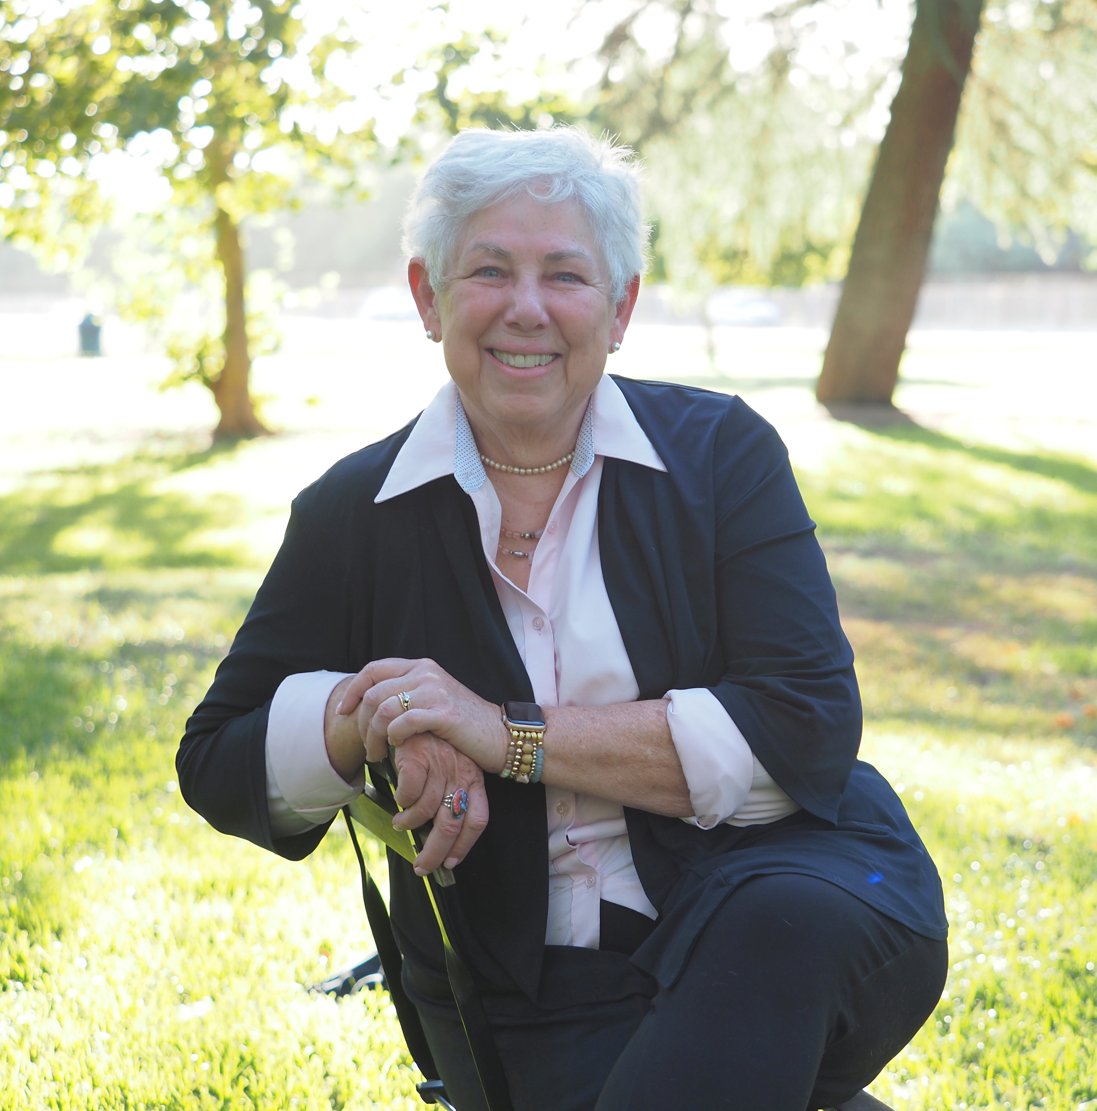
Your Presenters:
Sandra Breitengross Bitter, Director of the Independent Living Training and Technical Assistance Center for Independent Living
Paula McElwee, Director of Technical Assistance at the Independent Living Training and Technical Assistance Center for Independent Living

Slide 5
Challenges for CIL boards
Understanding and promoting the IL philosophy
Hiring and supervising the Executive Director
Legal responsibilities
Financial management responsibilities
Would you agree?

Slide 6
The IL Philosophy: Your Mission & Beyond
Embody and put into practice consumer control - in your governance, in your day-to-day operations, and in your interactions in the community.
In the case of the SILC, your council must be made up of a majority (51% or more) of members who have a disability, but do not work for either a CIL or the state.
This assures that it isn't run by professionals, but by consumers who are living day-to-day life outside a CIL.
You operate based on your SPIL, which should give evidence of advocacy and system change so that your state is responsive to the IL Philosophy in all its operations.

Slide 7
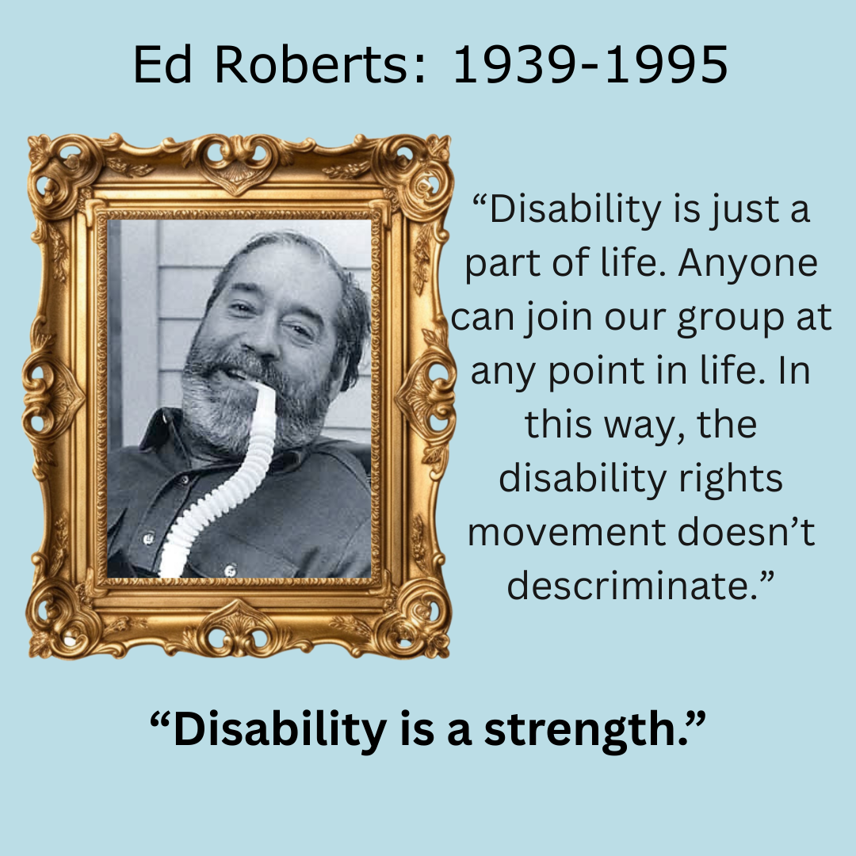
Highlights from the story of Independent Living
The IL movement beginnings: late ‘60s, early ’70’s
Conceptualized by Ed Roberts of Berkeley CA as a moral imperative, NOT a social services model.
A few centers predated funding through the Rehab Act, like the ones in Berkeley CA or Atlantis in CO. Do you know of others?

Slide 8
Highlights from the story of Independent Living (cont.)
People with disabilities need to be able to exert control over their own lives and decisions affecting their lives.
Centers were developed in the early 80s and into the 90s as new funds became available through the states and through the Rehabilitation Act. There has been little recent expansion of the number of CILs.

Slide 9
The Rehabilitation Act
Title VI – Employment Opportunity
Title VII – Independent Living Services
Title I – Vocational Rehab Services
Title II – Research & Training
Title III – Professional Development & Special Projects
Title IV – Nat’l Council on Disabilities
Title V – Rights & Advocacy

Slide 10
There are also regulations: 45 CFR 1329.2 quotes the Rehab Act’s Purpose for IL
The purpose of title VII (7) of the Act is to:
promote a philosophy of independent living (IL), including a philosophy of :
in order to maximize the:
leadership, empowerment, independence, and productivity of individuals with disabilities, and to promote the integration and full inclusion of individuals with disabilities into the mainstream of American society...
Consumer Control | Peer Support
Self-Help | Self-Determination
Equal Access | Individual and Systems Advocacy

Slide 11
By funding the SILC and the CILs... These principles bring us together
Consumer control
Peer support
Self-help and self-determination
Equal access Individual and system advocacy
Maximizing leadership, empowerment, independence, and productivity of individuals with disabilities
Integration and full inclusion of individuals with disabilities into the mainstream of American society

Slide 12
Promoting and Implementing the IL Philosophy: Your Mission & Beyond
IL is NOT about:
Charity
Saviorism
Serving or helping the “needy,” “vulnerable,” “folks with special needs,” or the “voiceless.”
IL IS about:
Empowering peers to lead and control their lives.
Ensure mission and the resulting State Plan for Independent Living upholds the rights of individuals with disabilities to be fully and meaningfully engaged members of their communities.
Notes:
Centers have always provided a range of core services (advocacy, independent living skills training, peer support, information & referral) to youth and young adults before the “transition” requirement of WIOA. Those services may or may not have been identified as supporting transition to postsecondary life. Each CIL has had its own approach to serving youth. The changes in the law are an additional factor in determining to what degree a CIL will serve youth.
Advocacy may—
Involve representing an individual—
Before private entities or organizations, government agencies (whether State, local, or Federal), or in a court of law (whether State or Federal); or
In negotiations or mediation, in formal or informal administrative proceedings before government agencies (whether State, local, or Federal), or in legal proceedings in a court of law; and
Be on behalf of—
A single individual, in which case it is individual advocacy;
A group or class of individuals, in which case it is systems advocacy; or
Oneself, in which case it is self-advocacy.
An essential skill area for all people as they move into adulthood is self-advocacy. Self-advocacy often leads to broader skill sets as individuals mature in their understanding of the larger social and cultural issues that affect them as well as others. As you meet with youth and they share their lives, areas for advocacy or self-advocacy will naturally emerge. Take the time to discuss these advocacy issues and assist individuals or groups to stand up for their rights through self-advocacy and participation in the community’s larger systems change issues. Involvement in the community is often an important step in developing leadership skills that become transferable to many aspects of independent living. An individual can receive both advocacy and transition services. Advocacy can BE a transition service.

Slide 13
What are your legal responsibilities?
Criminal accountability of boards
Civil accountability of boards
Individual board member accountability/responsibility
Risk Management
Insurance

Slide 14
Legal Responsibilities of the Board & Board Members
Board / Council Members = Mission Fulfillment & Organizational Integrity
Duty of Care
Duty of Loyalty
Duty of Obedience
Executive Director / Other Staff = Day to Day Operations

Slide 15
Duty of Obedience
Board members must be true to the mission of the SILC.
Board members must not act in a manner that is inconsistent to the mission.
Board members must act in observance of the local, state and federal laws and regulations that apply.

Slide 16
Duty of Loyalty
This includes the principle that the board members will make all decisions without personal conflict of interest.
A failure to meet a duty of loyalty may result in payment of restitution.

Slide 17
Duty of Care
Ensuring no foreseeable physical harm because of its work.
Make reasonable decisions based on facts that will ensure there is no negligence on the part of the organization.
Overseeing financial accountability to ensure that the public funds received are treated with care.
In order to perform your “Duty of Care” you need to understand a few things about federal funding...

Slide 18
Federal Regulations Regarding Finances
Regulations are found in "Uniform Guidance or 2 CFR 200".
These regulations outline the allowability of federal spending.
Costs must be necessary and reasonable.
Some costs are specifically not allowed under any circumstances (such as alcohol, bad debts or fines, most food).
Costs must be treated consistently – you can’t charge it to one program this month and a different one next month, if you have more than one funding source or program.
As a board you will want a financial review or audit annually to assure funds are spent as you believe they were. Auditors are secured by and report to the council/board.

Slide 19
Board Oversight & Responsibilities
Operational Responsibilities
Because the majority of board members have a significant disability you have disability input into these areas, but you may also want to solicit input from the disability community, especially into planning for the future.
Purpose | Planning | Policies
Disability Input

Slide 20
Role of Executive Committee vs. Executive Session
Any role other than the role of the full council must be described in policy and procedure.
Because of the open meeting requirements, the executive committee cannot operate independent of the council as a whole.
An “executive session” is defined in your state’s open meeting law, but typically can allow closed meetings only for the discussion of a personnel or legal item. The decision made there must be carried forward to the open meeting and voted on in open session.
IT IS NOT THE SAME AS THE EXECUTIVE COMMITTEE! Your state may require that committee meetings are also open, including your officers or executive committee.

Slide 21

The Council May Delegate Specific Duties to the Chair
Drafting the agenda with the Executive Director or other staff
Reviewing monthly financial statements in between quarterly SILC meetings.
Approving certain types or amounts of expenditures.
Approving the time documents of the ED.
Evaluating the performance of the ED in a one-to-one meeting.

Slide 22
Hiring/Supervising the Executive Director Important Reminders for Recruiting and Hiring
The Independent Living Movement is a disability-led movement created by us (individuals with significant disabilities) for us (individuals with significant disabilities).
While there are no requirements that you hire a SILC director who has a disability, think about this –
Disability representation in SILC executive leadership roles is crucial. You are allowed to require that the SILC hire staff who have a disability.
The lived experience of parents, caregivers, guardians, siblings, advocates/allies, service providers, etc. with children, loved ones, and/or clients with disabilities does NOT equate to the lived experience of individuals with disabilities.
You are required to evaluate the performance of the Executive Director.

Slide 23
Hiring/Supervising the Executive Director Recruting and Hiring Reminders Continued!
Hire someone who supports your mission and truly understands/embraces the IL Philosophy.
Know your challenges and recruit someone with the capacity and expertise to find solutions.
Review the position description and make sure it reflects what you want at this point in time. (Yes, your challenges may evolve and change.)
Determine the job duties/responsibilities and equitable pay/ compensation for the ED member.
Advertise within the IL movement. (Your membership organizations will assist with this, as will the T & TA Center.)
Review the performance of the ED annually. (Typically, this is done by the chair or a committee of the council, not the full council, just to ensure open dialogue.)

Slide 24
Financial / Fiscal Responsibilities
Development or resource plan in the SPIL
Annual budget process
Accounting and auditing guidelines
Allowability of costs
Bank reconciliation
Cash management
Code of ethics including conflict of interest

Slide 25
Financial / Fiscal Responsibilities (cont.)
Your policies and procedures should address:
What financial statements or reporting the council/board wants to see (often this comes from the DSE for the larger Part B grants, from your ED for the direct expenses of the SILC)
Expenditure limits for staff (when is board prior approval required?)
Internal controls (separation of duties)
Inventory controls
Procurement – processes and approvals
Payroll and time/effort reporting
Travel and operational expenses of ED

Slide 26
Conflicts of Interest
Board members and employees should avoid any activity, investment, or association that might interfere with or conflict with their judgment or duties.
Conflicts of interest must be disclosed as soon as possible.
Members should immediately disqualify themselves prior to discussion or voting on any matters where there is or even a possibility of a conflict of interest.
The policies and code of ethics should state that members must reveal the conflict as soon as possible and refrain from voting, discussing, or making decisions related to the conflict.

Slide 27
Nepotism
The council should not hire a family member of a board member.
If a family member applies, we suggest the council member should resign before the individual can be considered.

Slide 28
Codes of Ethical Conduct
Your policies should include a code of ethics and standards of professional conduct for both your staff and council members. Standards expected could include:
Acting professionally, competently and honorably.
Fulfilling assigned duties.
Complying with standards established in performance appraisals.
Maintaining an acceptable level of performance and conduct on all verbal and written job duties.
Using funds prudently.
Reporting conditions and circumstances that may prevent the member from performing their duties effectively and safely.

Slide 29
The good, the bad, and the ugly!

Slide 30
When you're on the RIGHT track! | When you're on the WRONG track!
Diverse, inclusive, and equitable board composition beyond the minimum required standards – reflective of voices and lived experience of most marginalized, representative of diverse experiences in your service area. Respects / adheres to the delineation of duties regarding the Executive Director and additional staff conducting day-to-day operations. | Tokenism in board recruitment and composition. Failure to provide members with meaningful training so they understand and accomplish their role. Lack of consumer control (out of disability composition compliance).

Slide 31
When you're on the RIGHT track! | When you're on the WRONG track!
High level of meaningful engagement by individuals with disabilities in SILC efforts, especially in the development of the SPIL. Strong Code of Conduct/Ethics (including sound conflict of interest policy/procedures). Robust succession planning for board members as well as the ED. The board knows what is happening at the high level of how public meetings occur, what the overall financial status is, and the role of the partners in accomplishing the SPIL. Term limits with a required year off periodically to ensure fresh ideas and representation on the board. | Council failing to receive and/or understand financial statements. Financial statements not connected back to the SPIL resource plan and the required spending Lack of consumer control (out of disability composition compliance). Member taking a public position criticizing the organization. Violating policies regarding discrimination and sexual harassment or other forms of harassment.

Slide 32
How do you apply these and other regulations?
Call Paula if you aren’t sure, 1-406-243-5438 or paula.mcelwee@mso.umt.edu
Or ask your Program Officer.
The Program Officers are assigned by federal region and are listed on the ACL website. Go to https://acl.gov/programs/community-living-programs/office-independent-living-programs-contact-list and look for your state.

Slide 33
Contact Information
Independent Living Training & Technical Assistance Center
Rural Institute for Inclusive Communities at the University of Montana
📞 (406) 243-5300
✉️ ilttacenter@mso.umt.edu
🌐www.ILTTACenter.org

Slide 34
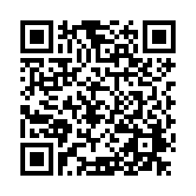
Evaluation Survey
Your feedback on this webinar is important to us. Please complete this brief evaluation survey. Here is the link:
https://umt.co1.qualtrics.com/jfe/form/SV_2sm0sYdqJ7hJQaO

Slide 35

Thank you on behalf of Independent Living Training and Technical Assistance Center for learning more today!
This project is on assignment through contract with the Administration on Disabilities, Administration for Community Living, Health and Human Services.

